Slide 1
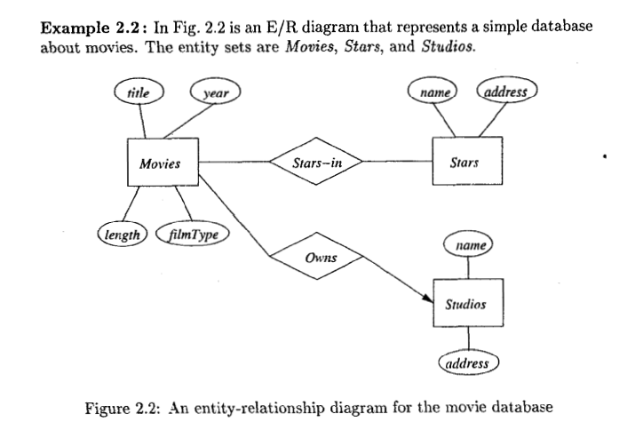
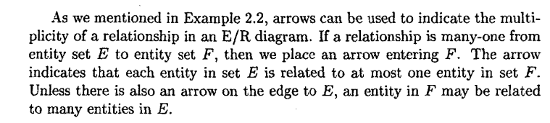
ER Diagram – Text Book

Slide 2
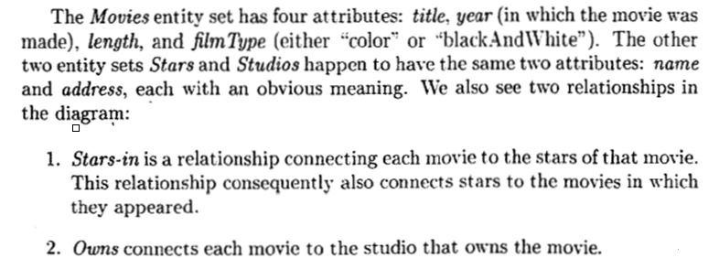
ER Diagram – Text Book

Slide 3
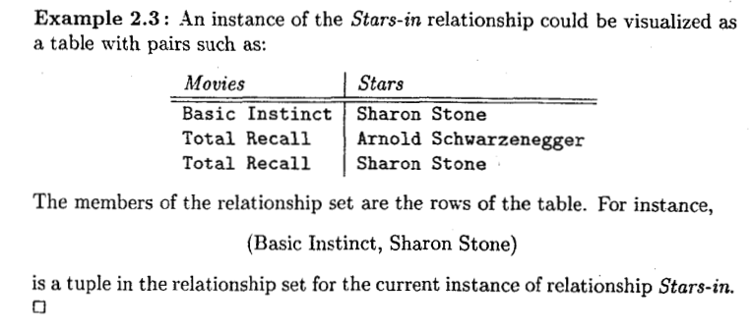
ER Diagram – Text Book

Slide 4
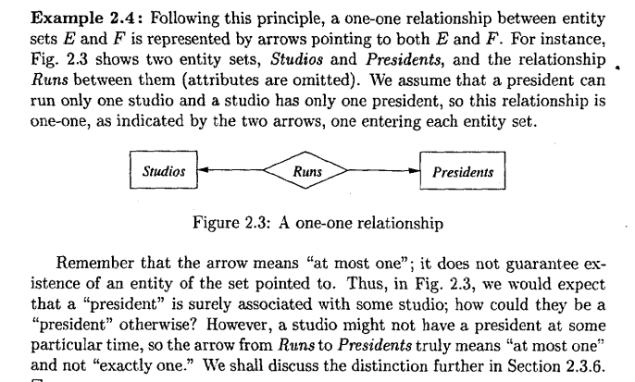
ER Diagram – Text Book

Slide 5
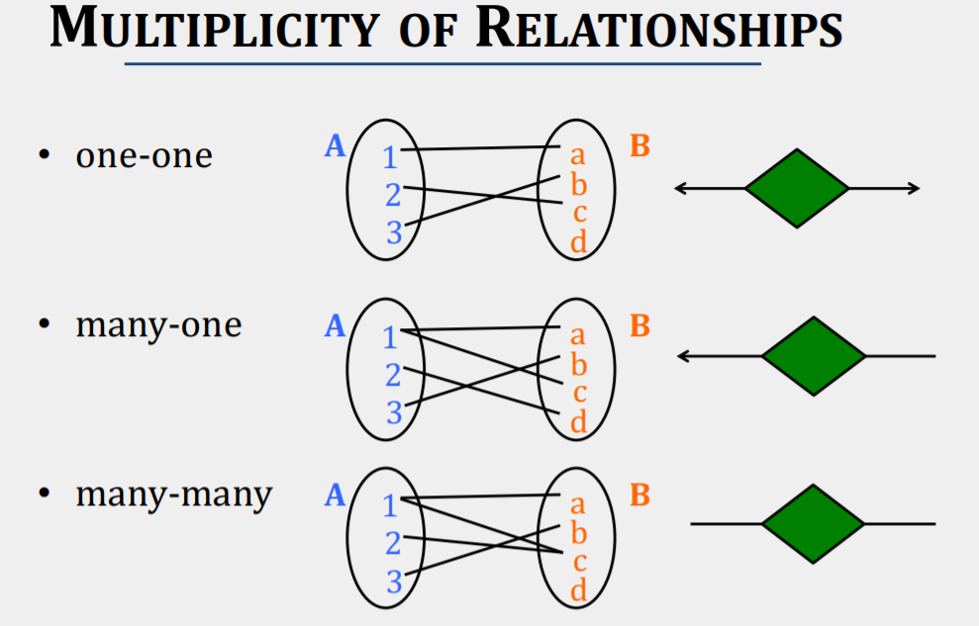
ER Diagram – Text Book

Slide 6
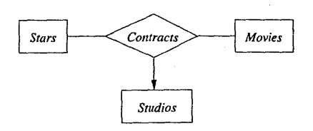
ER Diagram – Text Book
Multiway Relationship
A multiway relationship in an ER diagram is represented by lines from the relationship diamond to each of the involved entity sets.
Fig gives a relationship contracts that involves a studio, a star and a movie. This relationship represents that a studio has contracted with a particular star to act in a particular movie.
An arrow pointed to entity set Studio, indicates that for a particular star and movie there is only one studio with which the star as contracted for that movie.
A studio may contract with many stars for a movie and a star may contract with one studio for more than one movie.

Slide 7
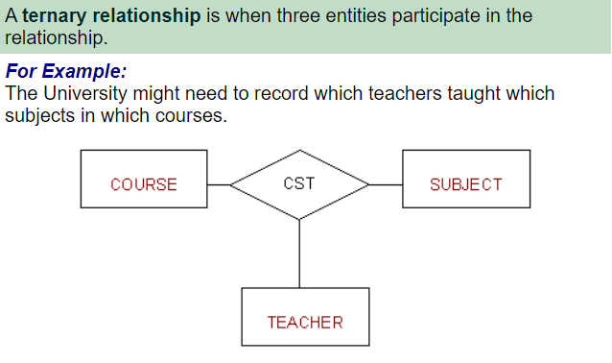
ER Diagram – Text Book
Multiway Relationship

Slide 8
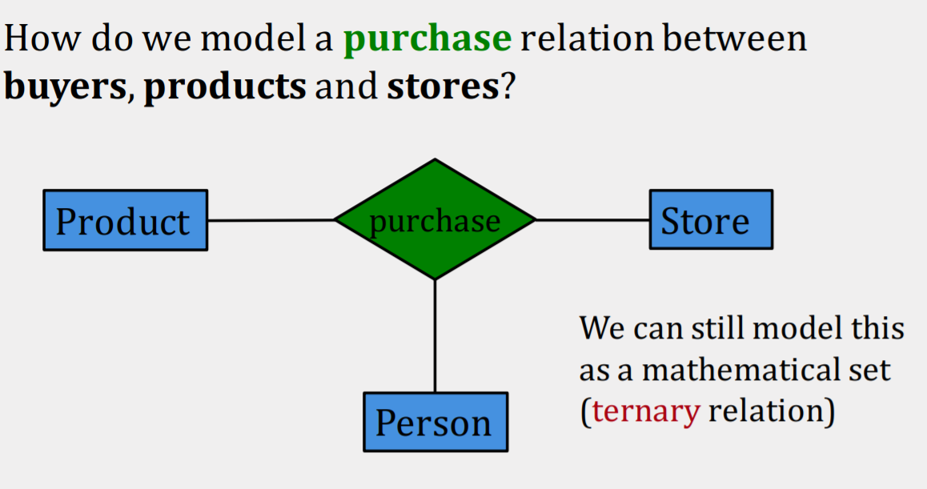
ER Diagram – Text Book
Multiway Relationship

Slide 9
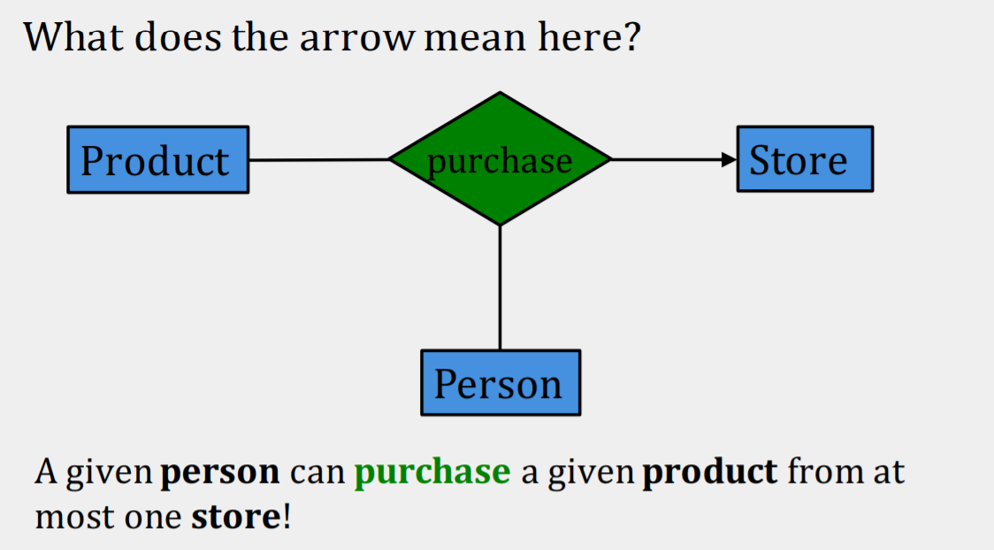
ER Diagram – Text Book
Multiway Relationship

Slide 10
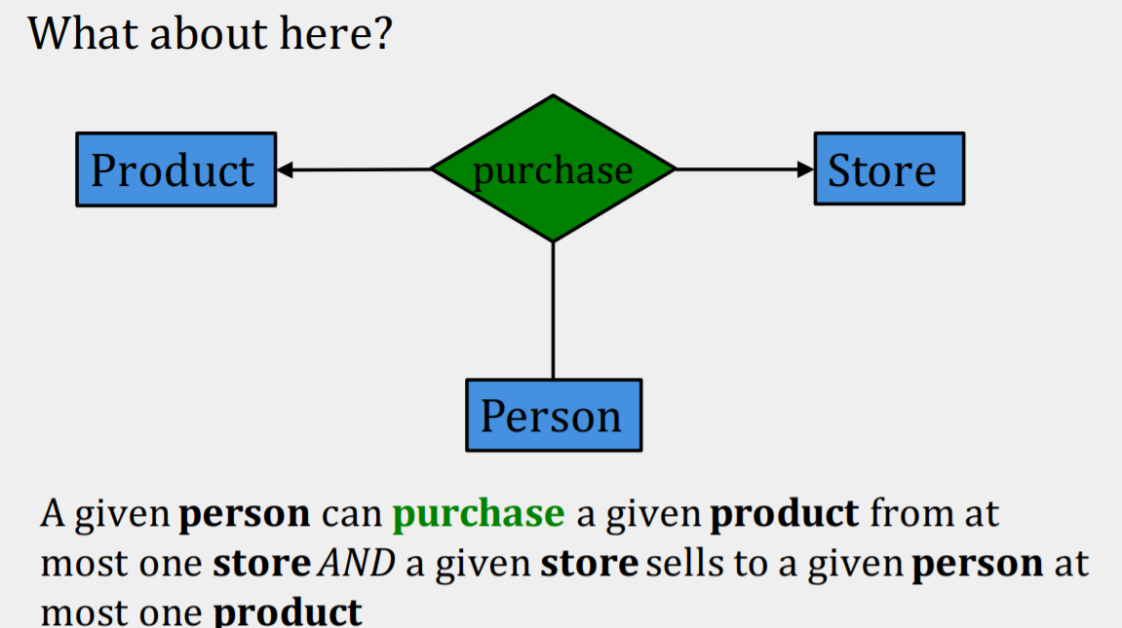
ER Diagram – Text Book
Multiway Relationship

Slide 11
ER Diagram – Text Book
Multiway Relationship

Slide 12
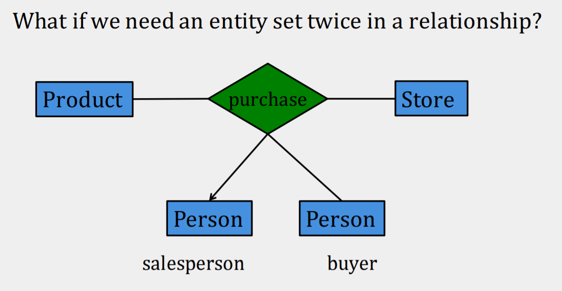
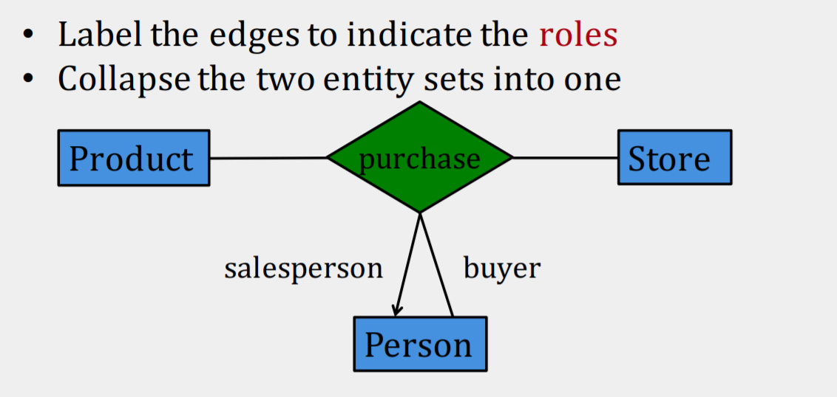
ER Diagram – Text Book
Roles in Relationships

Slide 13
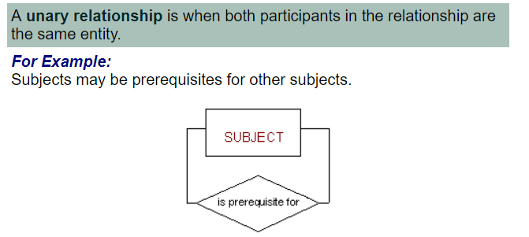
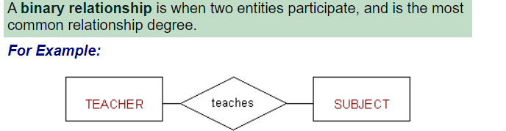
ER Diagram – Text Book
Roles in Relationships

Slide 14
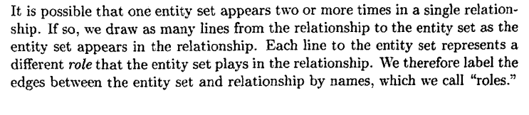
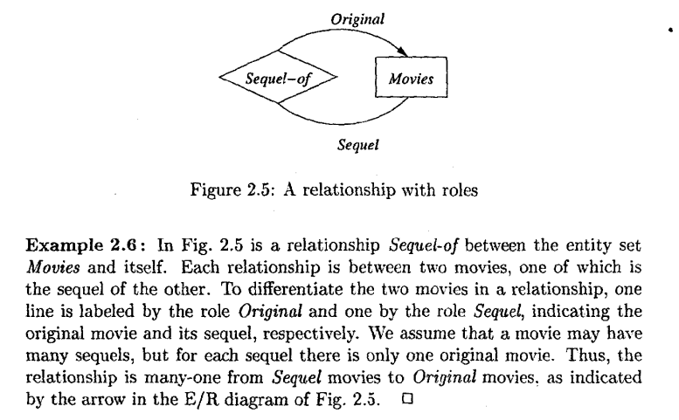
ER Diagram – Text Book
Roles in Relationships

Slide 15
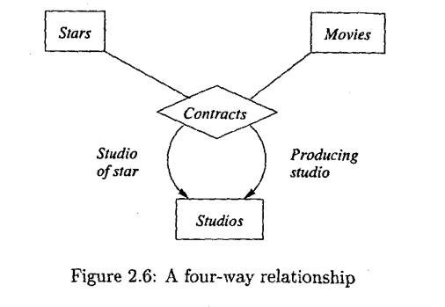
ER Diagram – Text Book
Roles in Relationships
Fig shows a multiway relationship and an entity set with multiple roles.
Relationship contracts involves two studios, a star and a movie.
One studio having a contract with a star may further contract with a second studio to allow that star to act in a particular movie.
Ex. Studio2 contracts with studio1 for use of studio1’s star by studio2 for the movie.
Given a star, a movie and a studio producing a movie, there can be only one studio that owns the star. Similarly only one studio produces a given movie.

Slide 16
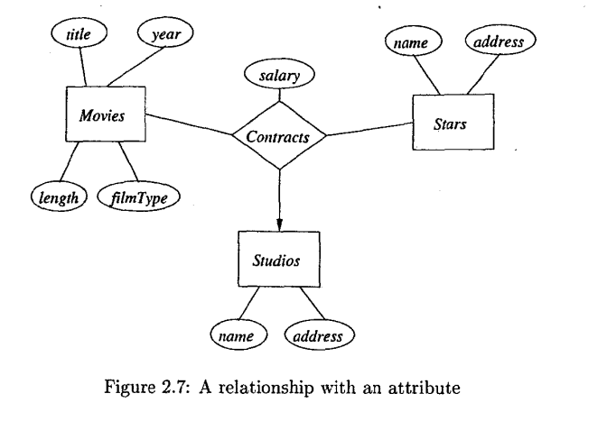
ER Diagram – Text Book
Attributes on Relationships
Sometimes it is convenient to associate attributes with a relationship.
Incase we need to record the salary associated with each contract between a star and a studio for a movie.
We cannot associate it with a star, since star might get different salaries for different movies.
Similarly, studio might pay different salaries to different stars.
Instead of placing attributes directly on a relation, a new entity set can be created and attributes can be place in the entity as given in the next slide.

Slide 17
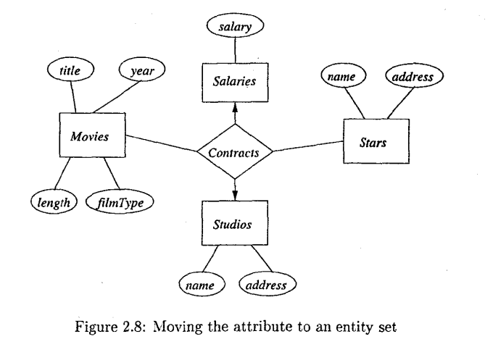
ER Diagram – Text Book
Attributes on Relationships

Slide 18
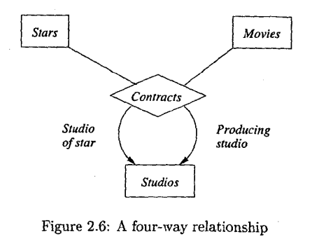
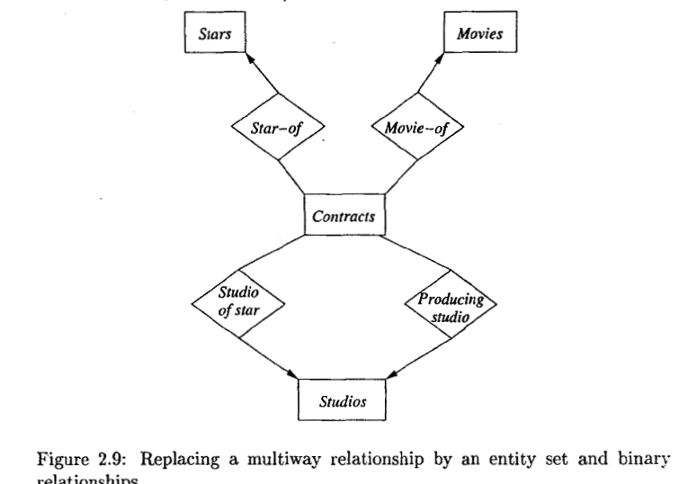
ER Diagram – Text Book
Converting multiway relationships to binary

Slide 19
ER Diagram – Text Book
Subclasses in the ER model
An entity set contains certain entities that have special properties not associated with all members of the set.
So certain entity sets or subclasses are defined with its own special attributes and/or relationshipts.
The entity set is connected to subclasses using a relationship called is-a.
Each isa relationship is represented by a triangle. One side of the triangle is attached to the subclass and the opposite point is connected to the superclass.

Slide 20
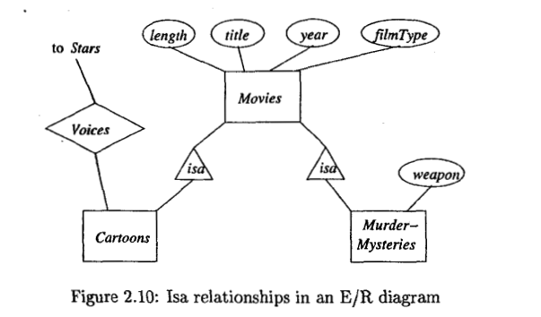
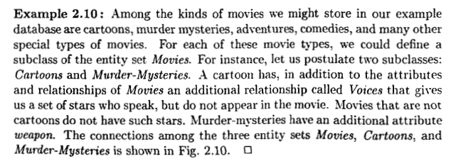
ER Diagram – Text Book
Subclasses in the ER model

Slide 21
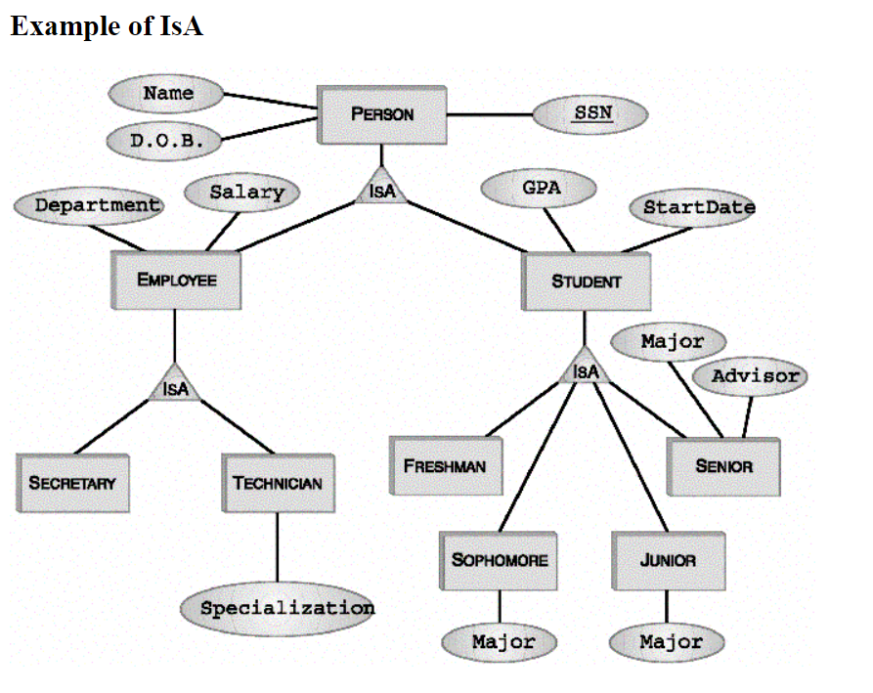
ER Diagram – Text Book
Subclasses in the ER model

